Slide 1
Getting Started with Splunk
Name- Meraj Hussain

Slide 2


Introductions
Who are you?
What is your role?
Where does your job start and end?
Who’s in the audience?
Have the audience introduce themselves?
How much experience do they have with Splunk?
What do they hope to gain from this?

Slide 3
Introduction to Splunk
What is Machine Data?
What is splunk?
Product of splunk Enterprises
Splunk developer/Admin roles and responsibilities
Splunk Use cases

Slide 4
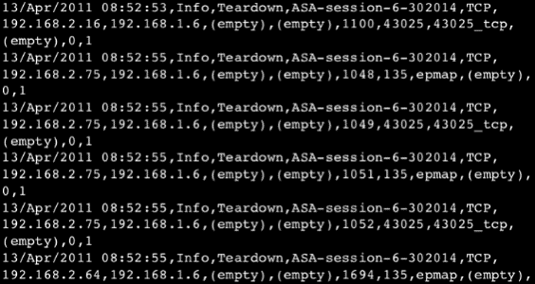
Machine Data

Slide 5
Complex to understand
In an unstructured format
Not suitable for making analysis / visualization
This is where a tool like Splunk comes in handy. You can feed the machine data to Splunk, which will do the dirty work(data processing) for you. Once it processes and extracts the relevant data, you will be able to easily locate where and what the problems were.

Slide 6


What is Splunk
Splunk is a software platform to search, analyze and visualize the machine-generated data gathered from the websites, applications, sensors, devices etc. which make up your IT infrastructure and business.
Its Log collection OR Log management
Infra monitoring tool
Application Performance Monitoring tools
BIG data
SIEM(Security Information and Event Management)
Google of your Data
The other benefits with implementing Splunk are:
Your input data can be in any format for e.g. .csv, or json or other formats
You can configure Splunk to give Alerts / Events notification at the onset of a machine state
You can accurately predict the resources needed for scaling up the infrastructure
You can create knowledge objects for Operational Intelligence (Splunk UBA)

Slide 7
Splunk advantages
It is quite necessary to know why any company should adopt this technology. Read below to find out:
It started working as the ‘Google’ for log files.
Searches using simpler terms with the help of Search Processing Language (SPL).
Does not require any backend or any database as it stores data directly in the Splunk file system.
Not a single point of failure is encountered.

Slide 8
Product of Splunk
Splunk Cloud
Splunk Enterprise
Premium Apps OR Splunk Base

Slide 9
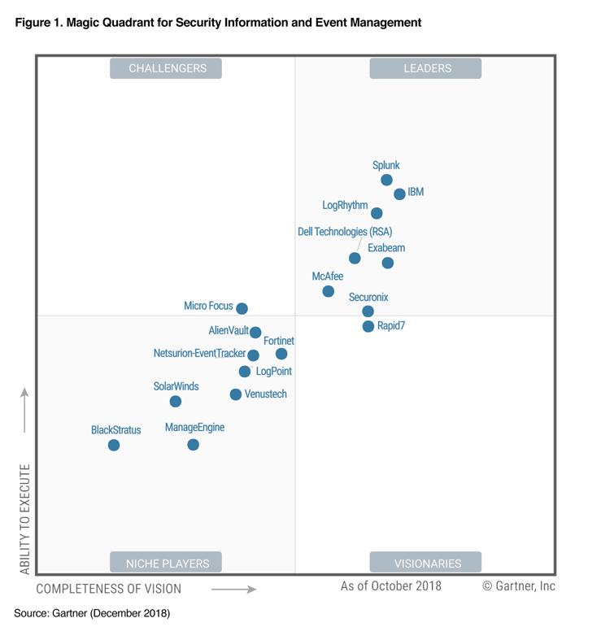
Magic Quadrant of SIEM

Slide 10
Use Cases

Slide 11
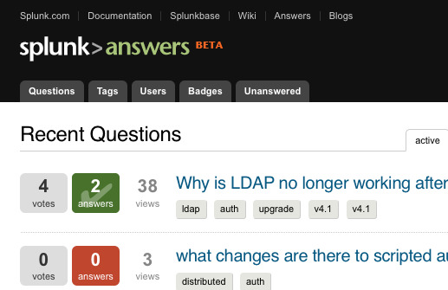
Technical Help: Splunk Answers
http://answers.splunk.com
Community driven
Splunk supported
Knowledge exchange
Q & A
Notes:
Splunk Answers(http://splunk-base.splunk.com/answers/ or http://answers.splunk.com) is a web based Splunk community which can be utilized to answer questions.
Many Splunk employees are users and check the site on a regular basis. We are happy to provide feedback on the questions being asked here. This is an excellent option for people who do not have direct access to Splunk support to find quick answers to their questions. This site is a great place to see if other people may have encountered a similar issue to the one you are experiencing. We encourage Splunk users to utilize this resource as a first line of investigation.
We welcome you to engage the Splunk community for any and all questions you may have related to Splunk. It is a friendly community full of people who are willing and able to assist you with your inquiries. It can be useful in answering basic questions , or even questions about advanced deployment use cases. Whatever you'd like to know about Splunk, there is a good chance someone in the community has this knowledge, and is willing to share it with you.

Slide 12
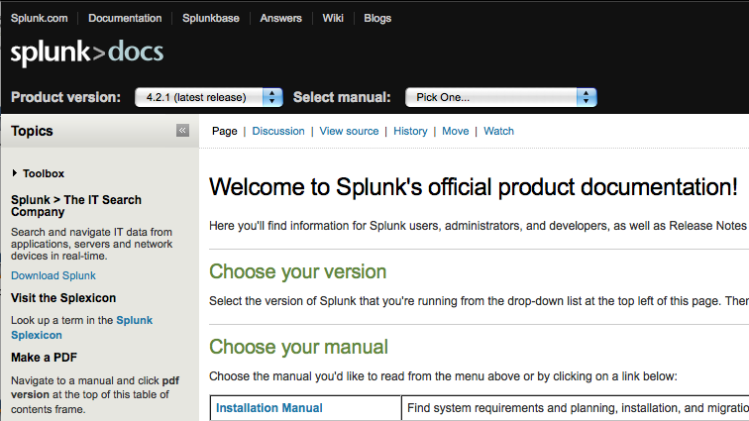
Technical Help: Splunk Documentation
http://docs.splunk.com
Official Product Docs
Wiki and community topics
Updated daily
Can be printed to .PDF

Slide 13
Splunk Events
Splunk User Groups
Community driven
Bootstrapped by Splunk
Occur every 2-3 months
Hosted locally
Splunk Live!
Worldwide customer events
Technical workshops for beginners and power users
Local Events held in LA, OC, San Diego, Phoenix yearly
Splunk User Conference
August 15-17 in San Francisco, CA
5 tracks, more than 40 sessions, the smartest Splunk users together
May 13th early registration promotion
www.splunk.com > Events
Notes:
Splunk User Groups
From time to time, there are also Splunk User Group meetings at various locations around the country and world, which you can attend to learn how other customers are currently using Splunk.
To find out about upcoming events in your area, be sure to check out the upcoming events section of the Splunk website @http://www.splunk.com/page/events

Slide 14
Other Ways to Get Help
 | Post a Question to Splunk Answers
 | Find an app on Splunkbase
 | Join the IRC channel #splunk on efnet
 | Join the Splunk LinkedIn Group
 | Follow @Splunk on Twitter
 | Watch Splunk Videos on YouTube

Slide 15
Thank You :)

